Slide 1
Implementing IoT Projects A Building Block Approach
Radhanand Anantha
Gokaraju Rangaraju Institute of Engineering & Technology (GRIET)
Hyderabad

Slide 2
Agenda
1
Introduction to IoT, Building Blocks in IoT, IoT eco-system
GitHub resources: Sensor interface, OLED, Firebase, Mobile App
5
2
GISMO board: introduction, features, resources, versions, sensors supported
6
Firebase: Introduction, Creation of Realtime Database, Access with Arduino
3
Arduino IDE: Introduction,Basics, Add-on for ESP32 programming
7
Kodular: Introduction, Basic apps, Firebase access
4
Getting Started: LED,Relay,Magnetic Switch, Soil Moisture, WiFi, Firebase
8
Projects: Putting all the blocks together for complete projects

Slide 3

Internet of Things - IOT
Information
Control
A system of internet-connected ‘things’ that can collect and transfer data over a wireless network without human intervention

Slide 4
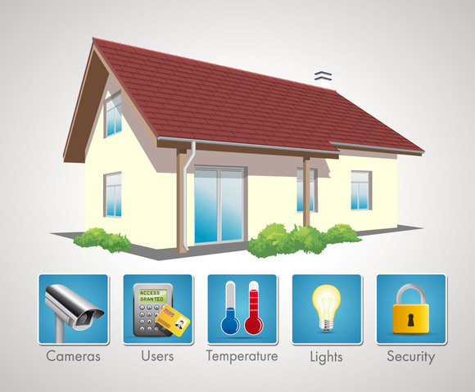
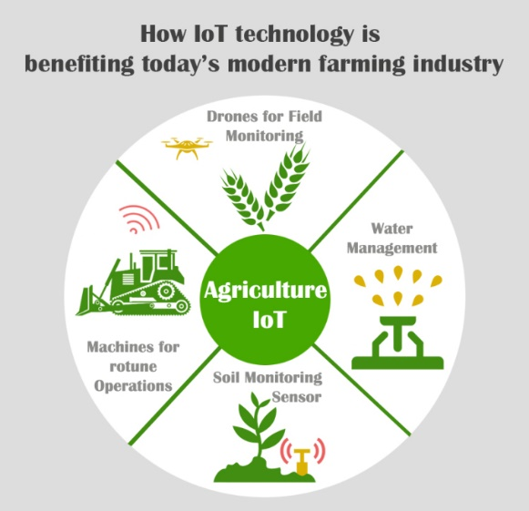
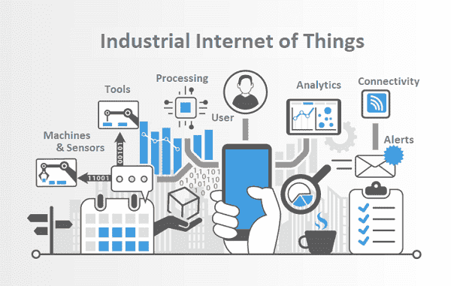
IOT Applications
Intrusion detection
Door/Window open
LPG Gas Leak detection
Appliance Control
Soil moisture
Temperature, humidity, leaf wetness sensing
Watering schedules
Industrial IOT
Manufacturing plants
Process plants

Slide 5



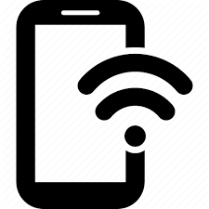

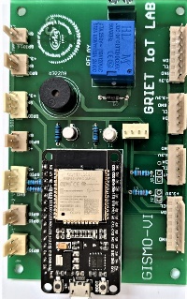


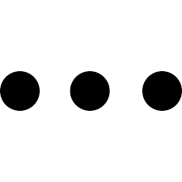
IoT Projects
Cloud
IOT eco-system
Sensors
Microcontroller Board
Sensor Interfaces
WiFi
Internet Connectivity
Cloud Database
UI using mobile app
Mobile
GISMO-VI
GRIET IoT Sensor Module

Slide 6
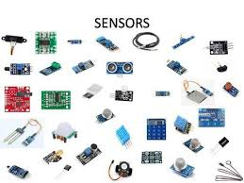
Project Building Blocks
Mobile App
Cloud database interface
Internet connectivity
Sensor data processing
Environment monitor
Range meter
Sound detector
Gesture recognition
Fall detector
Sensor/ Actuator interface
Smart garden
IR based appliance control
Real time based appliance control

Slide 7
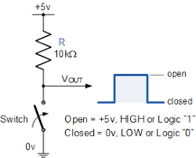
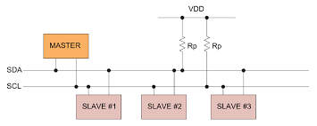
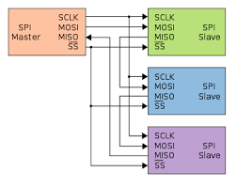
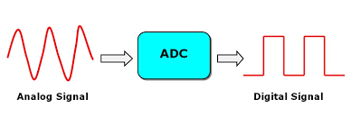
Project Building Blocks
Sensor Interface
Serial
Parallel
Analog
Digital
I2C
SPI

Slide 8
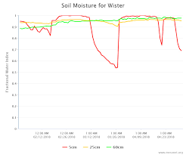
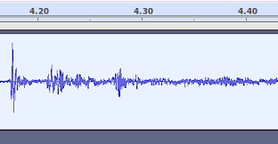
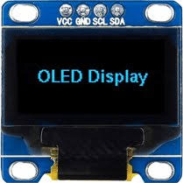
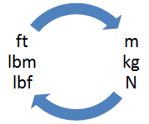
Project Building Blocks
Data Processing
Limit checking
Engg. unit conversion
FFT computation
Local display

Slide 9
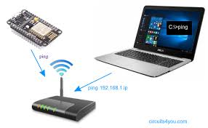
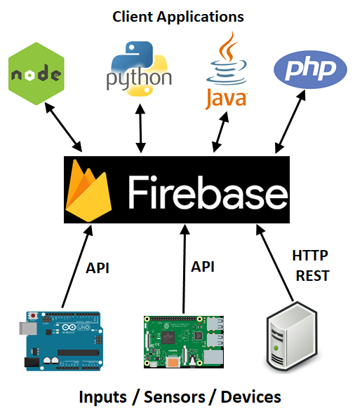
Project Building Blocks
Internet connectivity & Cloud database
Joining WiFi network
Connection status to Internet
Data access from cloud database

Slide 10

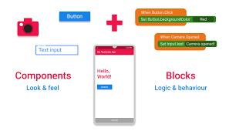
Project Building Blocks
Mobile App Development
UI Design
Cloud database interface
Periodic update

Slide 11

GISMO VI
Resources
ESP32 DevKitC
Relay
Buzzer
Polarized connectors for:
OLED graphic display
BMP280 Environment sensor
MPU6050 3-axes accelerometer & gyro
Soil moisture sensor
APDS 9960 Gesture and Color sensor
HC-SR04 Ultrasonic sensor
PIR sensor
Magnetic switch
MAX30100 Heart rate and SPO2 sensor
INMP441 MEMS microphone

Slide 12
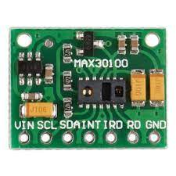
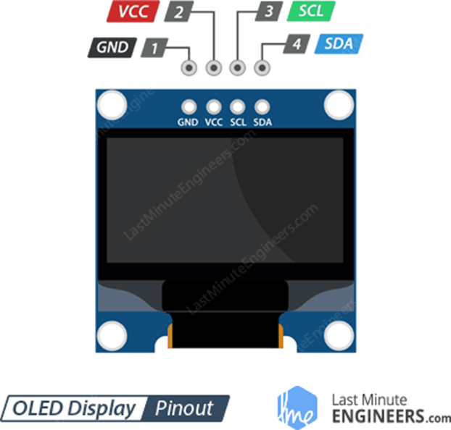
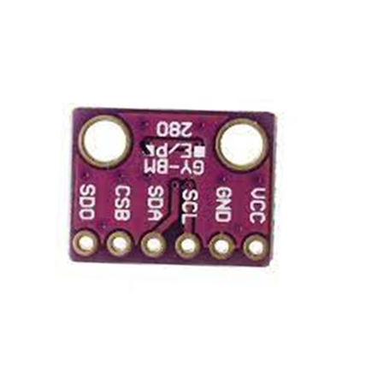
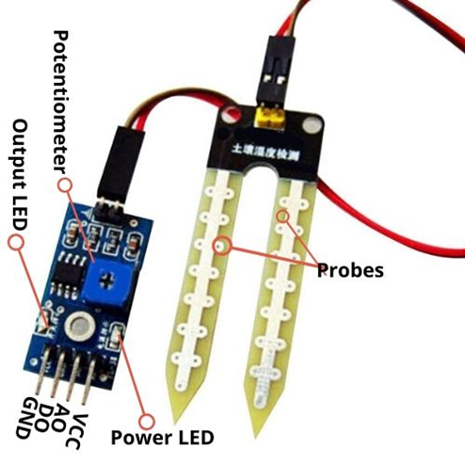
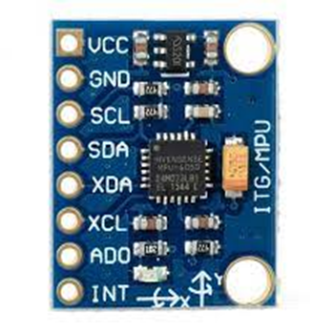
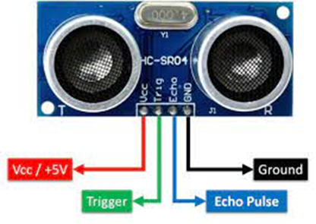
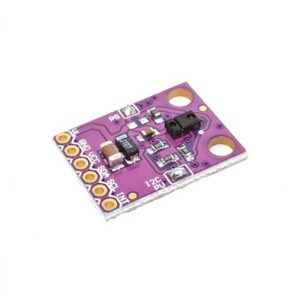
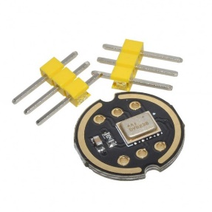
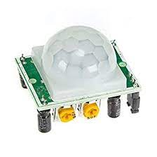
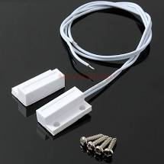
Sensor Pack
Heart rate & Pulse Oximeter
OLED graphic display
BPM280 Environment sensor
MPU6050 3-axes accelerometer & gyro
HC-SR04 Ultrasonic sensor
Soil moisture sensor
APDS 9960 Gesture & Color sensor
Magnetic switch
INMP441 MEMS microphone
PIR sensor

Slide 13
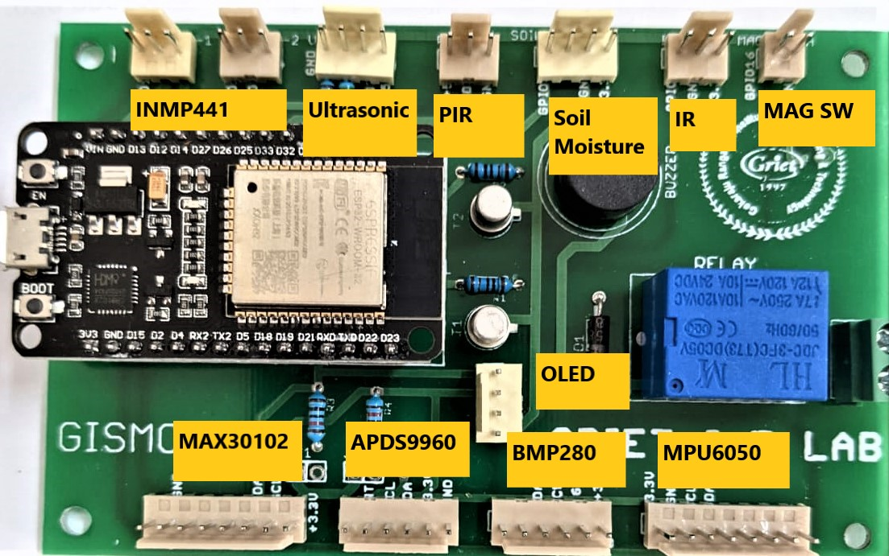
GISMO-VI Sensor Locations
Design Approach:
Fixed locations for sensors
Dedicated connectors
No interchanging of sensor locations
Advantage:
Sensor modules can be used off-the-shelf
Disadvantage
Cables can be connected reverse
Only specified sensors can be used

Slide 14
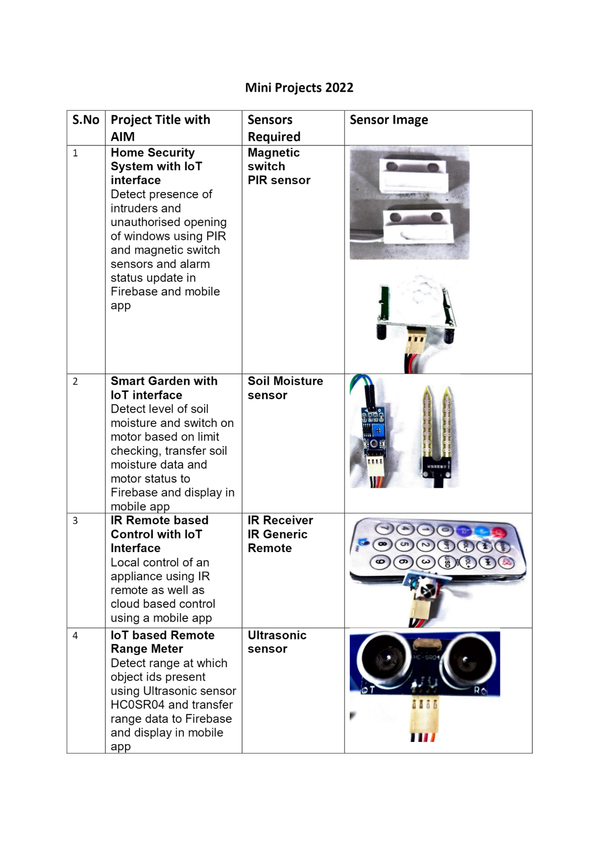
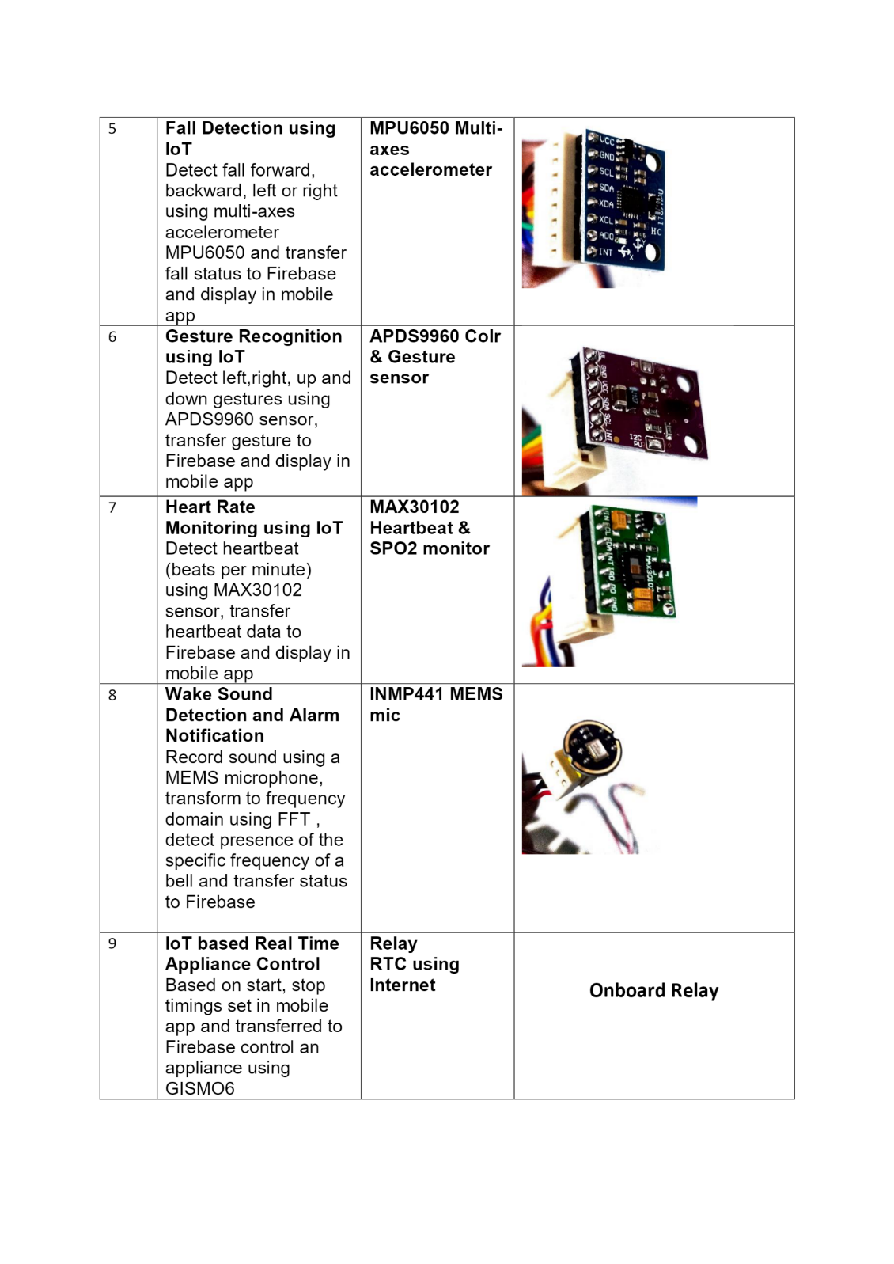

Do not disconnect the sensor from the cable

Slide 15
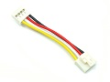
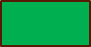
GISMO-VII
GROVE port
GROVE cable
Design Approach:
No fixed locations for sensors
Generic ports
ESP32
Modules- Sensor boards
Advantage:
Any sensor can be interfaced
Cables cannot be reversed
Disadvantage
Sensor modules cannot be used off-the-shelf
GROVE breakout board need for each module
GISMOVII board – Base unit

Slide 16
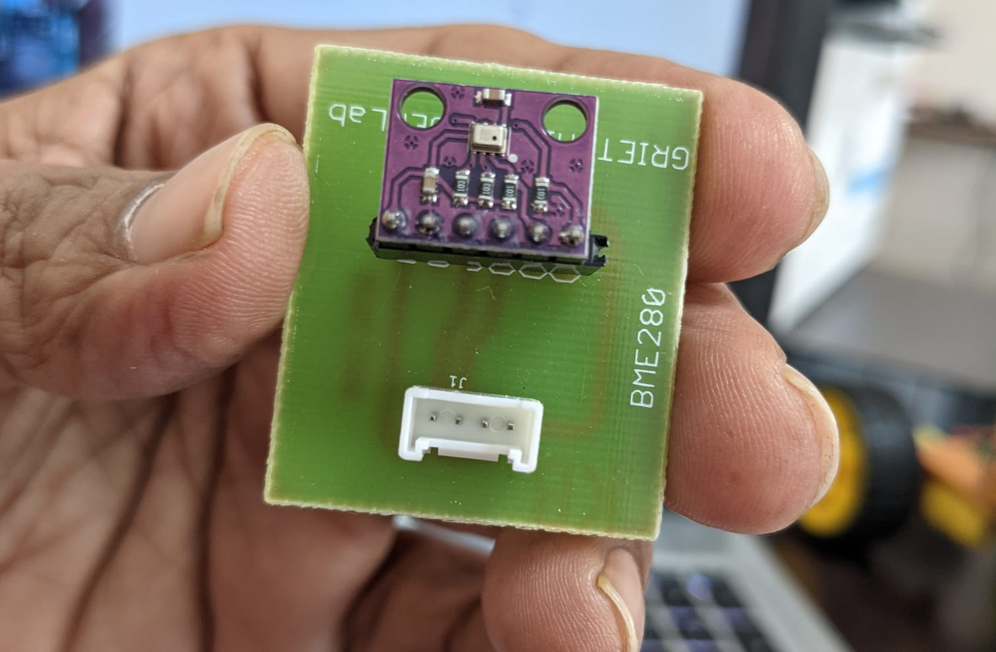
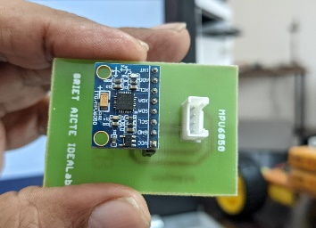
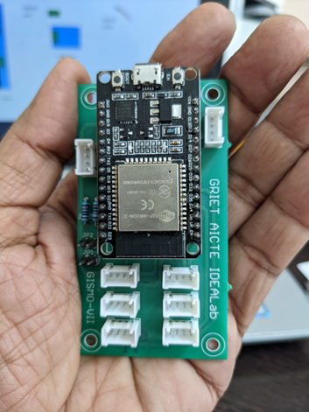
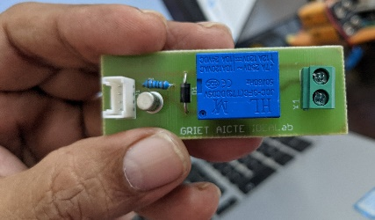
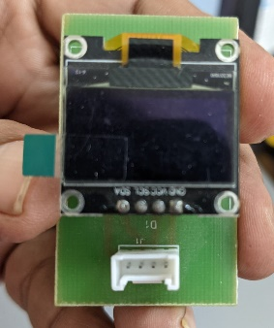
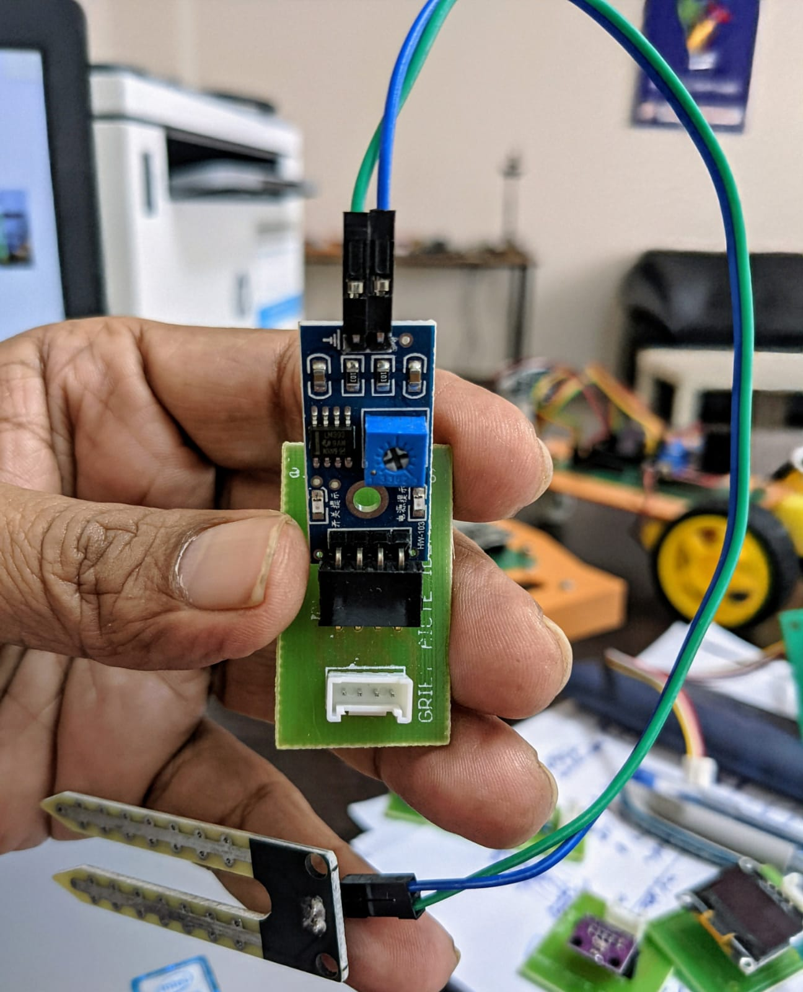
GISMO-VII
BM280 board
MPU6050 board
Relay board
GISMO-VII board
OLED board
Soil Moisture sensor board

Slide 17
GROVE ports
Grove is a modular, standardized connector prototyping system. Compared to systems using jumpers or solder, Grove's modular building-block approach makes assembling real electronics easy.
The Grove system consists of a base unit and various modules with standardized connectors.
GROVE ports on GISMO-VII
2 digital ports
2 analog ports
2 I2C ports
1 UART port
1 5V digital port

Slide 18

Grove ports
In the Grove UART module Pin 1 is the RX line (which the base unit uses to receive data, so it is an input) where Pin 2 is the TX line (which the base unit uses to transmit data to the Grove module).
The Grove I2C connector has the standard layout. Pin 1 is the SCL signal and Pin 2 is the SDA signal. Power and Ground are the same as the other connectors.
Signal | Description
RX | Receive of base unit
TX | Transmit of base unit
VCC | Supply 3.3V
GND | Ground
Signal | Description
SCL | I2C clock
SDA | I2C data
VCC | Supply 3.3V
GND | Ground

Slide 19
GROVE PORTS
A digital Grove connector consists of the standard four lines coming into the Grove plug. The two signal lines are generically called D0 and D1. GISMO7 modules only use D0
An Grove Analog connector consists of the standard four lines coming into the Grove plug. The two signal lines are generically called A0 and A1. Most modules only use A0.
Signal | Description
D0 | Primary digital input/output
D1 | Secondary digital input/output
VCC | Supply 3.3V
GND | Ground
Signal | Description
A0 | Primary analog input
A1 | Secondary analog input
VCC | Supply 3.3V
GND | Ground

Slide 20
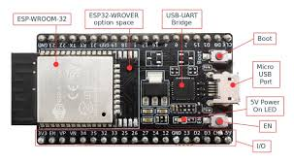
ESP32 Dev Kit
ESP-WROOM-32: 32-bit microprocessor
I/O pins: These pins are capable of Digital Read/Write, Analog Read/Write, PWM, IIC, SPI, DAC and much more.
Micro-USB jack: The micro USB jack is used to connect the ESP32 to our computer through a USB cable. It is used to program the ESP module as well as can be used for serial debugging as it supports serial communication
EN Button: The EN button is the reset button of the ESP module.
Boot Button: Press and upload program from Arduino IDE
Red LED: The Red LED on the board is used to indicate the power supply.
Blue LED: The Blue LED on the board is connected to the GPIO pin2.

Slide 21
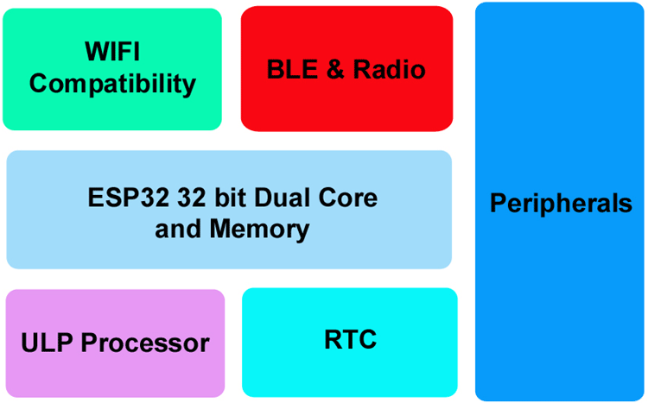
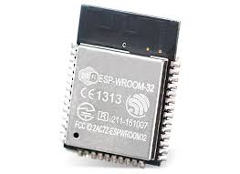
Inside the ESP32

Slide 22
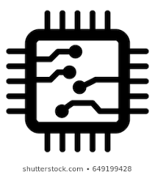
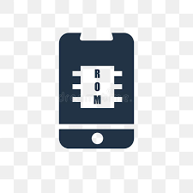
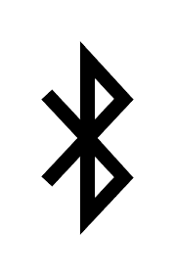
ESP32 features
ESP32 has Xtensa® Dual-Core 32-bit LX6 microprocessors. The ESP32 will run on breakout boards and modules from 160Mhz upto 240MHz
Internal Memory : 448 KB ROM for booting and core functions & 520 KB SRAM for data and instructions
External Flash : 4MB external Flash extendable to16MB
WiFi: ESP32 implements TCP/IP, full 802.11 b/g/n/e/i WLAN MAC protocol
Bluetooth : ESP32 supports the latest BLE Bluetooth 4.2, as well as classic Bluetooth

Slide 23

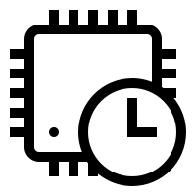
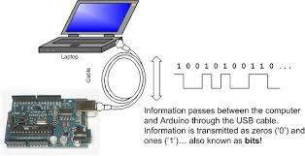
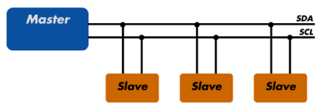
ESP32 peripherals
GPIO
Timers and Watchdog
Real Time Clock
ADC and built-in Sensors
Digital to Analog Convertor (DAC)
Touch Sensor
Ultra Low Power(ULP) Co-processor
Ethernet MAC Interface
Universal Asynchronous Receiver Transmitter (UART)
I2C Interface
I2S Interface
SPI Interface
Pulse Width Modulation (PWM)

Slide 24
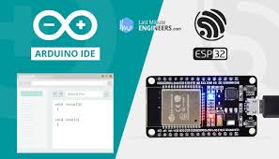
ESP32 – powering & programming

Slide 25
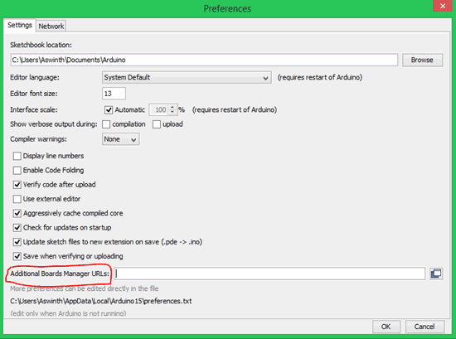
Preparing Arduino IDE for ESP32
STEP 1: Now, let’s get started. The first step would be to download and install the Arduino IDE.. If you already have one make sure it is of the latest version.
STEP 2: Once installed, open the Arduino IDE and go to Files -> Preferences to open the preferences window and locate the “Additional Boards Manager URLs:” as shown

Slide 26

Preparing Arduino IDE for ESP32
STEP 3: This text box might be empty or might also contain some other URL if you have used it previously for ESP8266. If it is empty simply paste the below URL into the text box
https://dl.espressif.com/dl/package_esp32_index.json

Slide 27

Preparing Arduino IDE for ESP32
STEP 4: Now go to Tools -> Boards -> Board Managers to open the Board manager window and search for ESP32.
If the URL was pasted correctly your window should find the below screen with Install button, just click on the Install button and your board should get installed.

Slide 28

Preparing Arduino IDE for ESP32
STEP 5: Make sure you have an active internet connection and wait while the installation gets complete. It may take few minutes based on the speed of your internet connection.

Slide 29

Programming ESP32 with Arduino
STEP 1: Connect your ESP32 board to your computer through the micro-USB cable. Make sure the red LED goes high on the module to ensure power supply.
STEP 2: Start the Arduino IDE and navigate to Tools -> Boards and select ESP32 Dev Module as shown

Slide 30

STEP 3: Open device manager and check to which com port your ESP32 is connected to. Mine is connected to COM 8 as shown

Slide 31

ESP32 – Arduino IDE
In the Tools tab, go to
Board -> ESP32 Arduino -> ESP32 Dev Module
In the Tools tab, go to
Port-> COMX

Slide 32
Arduino IDE
pinMode(2,OUTPUT);
pinMode(3,INPUT);
pinMode(4,INPUT_PULLUP);
2
4

Slide 33




The Arduino IDE
Input
Output
digitalRead ()
digitalWrite ()
Digital
analogRead ()
analogWrite()
Analog

Slide 34
Arduino Libraries
S.No | Sensor | Library
01 | OLED Display | ESP8266 and ESP32 OLED driver for SSD1306 displays By Thingpulse
02 | BMP280 | Adafruit BMP280 library By Adafruit
02A | BMP280 | Adafruit BusIO By Adafruit
02B | BMP280 | Adafruit_Sensor_Master zip file
03 | MPU6050 | MPU6050 By Electronic Cats MPU6050 Arduino Library
04 | Firebase | Firebase ESP32 Client By Mobizt
05 | APDS9960 | SparkFun APDS9960 RGB and Gesture Sensor By SparkFun Electronics
06 | IR Remote | IRRemoteESP8266 By David Conran et al
07 | MAX30102 | SparkFun MAX3010x Pulse and Proximity Sensor Library By SparkFun Electronics
Display
Environment sensor
Accelerometer
Cloud database
Gesture sensor
Infrared Remote
Heartbeat sensor

Slide 35
GitHub repository
URL: github.com/grietiotlab
Repository: GISMO-VI
Important docs:
Arduino libraries list GISMO-VI/GISMO6_Docs/Arduino Libraries.docx
GISMO-VI pin assignments GISMO-VI/GISMO6_Docs/GISMO-VI Pin Assignments.docx
Sensor Locations GISMO-VI/GISMO-VI_SensorLocations.jpg
Hardware schematic GISMO-VI/Hardware/gismoviv1.pdf

Slide 36


Getting Started
Onboard LED
On-board LED
Relay
Magnetic Switch
ESP32

Slide 37




Getting Started
Serial Communication
Soil Moisture sensor
OLED Display
WiFi
Firebase Write
Firebase Read

Slide 38





GitHub Organization
Serial
Monitor
Sensor
Serial
Monitor
Sensor
Display
Serial
Monitor
Sensor
Cloud
Database
Display
Serial
Monitor
Mobile
App
Cloud
Database
Sensor
Display

Slide 39

Github repositories
Github address: github.com/grietiotlab
Public repositories
No password required

Slide 40

Google Firebase
Creation of Google Firebase real-time database
Credentials of the database
Pushing data from Arduino framework to Firebase
Pulling data from Firebase to Arduino framework

Slide 41



Google Firebase
Google Firebase Real Time Database is a cloud hosted database
Log in can be done using your Gmail id
The Real Time Database is a NoSQL database and has only key-value pairs
Firebase Real Time Database credentials –
Host name
Database secret
Key | Value
Temperature | 30.7
Humidity | 87
Window status | Open
Motor status | ON

Slide 42


Google Firebase

Slide 43

Welcome screen of Firebase
Click on the Create Project button

Slide 44

Create just one Firebase project
The free Spark plan has a limit on the number of projects you can create

Slide 45

Type in your project name and accept the Firebase terms

Slide 46


Slide 47


Slide 48

Creating your project may take a while
Wait till your project is created and you get a prompt

Slide 49


Slide 50

Go to the Build group in the left pane and select Realime Database

Slide 51

Click on the Create Database button

Slide 52


Slide 53




Start the database in Test Mode.
Default option will be in Locked mode

Slide 54

The host name/URL of your database

Slide 55


Slide 56

Click on Project Overview/Project Settings/Service Accounts/Database Secrets

Slide 57

Copy database secret onto Clipboard

Slide 58
Google Firebase access using Arduino
#include < FirebaseESP32.h>//Arduino Firebase library for ESP32
#define FIREBASE_HOST “xxxxxxxxxxxxx.firebaseio.com”
#define FIREBASE_AUTH “xxxxxxxxxxxxxxxxxxxxxxxxxxx”
FirebaseData fbd;

Slide 59
Google Firebase access using Arduino
Key
Value
Firebase.begin(FIREBASE_HOST,FIREBASE_AUTH);
Firebase.setFloat(fbd,”IOTLAB/My_App/Sensor_Value”,value);
Firebase.getString(fbd,”IOTLAB/My_App/Motor_Cmd”,myString);
Pushing data
Pulling data

Slide 60

Mobile App Development - Kodular
Getting started with Kodular
Hello World in Kodular
Sample app in Kodular

Slide 61

What is Kodular?
Kodular is a free online suite for mobile apps development. It mainly provides an online drag-and-drop Android app creator, on which everyone can create any kind of app without programming a single line of code.

Slide 62



Kodular Companion
Kodular Companion is an Android app that will help developers using Kodular to live test their apps without exporting and compiling them
Kodular Creator in the Test tab has a Connect to Companion item that will open a 2D QR code that can be scanned by Kodular Companion

Slide 63

Understanding Kodular
The apps in Kodular are built as a combination of various Components , with each individual Component being used for a specific purpose.
The Component's behaviour is configured using Blocks

Slide 64

Components
Components are the basic building elements of any app in Kodular. Everything in the app is done with the help of one component or the other.
Different components are used for different purposes. One component may be used to design the User Interface(UI) of the app, for example a Button component, while others may be used for performing actions like communicating to a database, saving an image to the Android device's folder etc. for example the FirebaseDB component

Slide 65
Blocks
Blocks are ones which are used describe how to do a task. The way in which the Components respond to various actions and events in the app is designed using the Blocks.
For example, how the app should respond when a Button is clicked, what data is to be communicated to the database using FirebaseDB component etc. are all configured using the Blocks.
Thus, by using the various Components and by configuring its behaviour and response to actions from the user with the help of Blocks, an app is "koded" in Kodular.

Slide 66
Types of Components
Visible Components: The components that can be viewed in the Viewer panel of the Designer page are known as Visible Component. They are visible to the user in the app and the user can interact with it directly and help in building the User Interface of the app.
Non-Visible Components: The components that are not viewed in the Viewer panel of the Designer page are known as Non-Visible Component. They are the components that usually do other things like saving a file to the device's storage, getting data from various sensors of the device etc.

Slide 67
Types of Blocks of Components
Each Component has its own set of blocks, divided into three types:
Property blocks
Method blocks
Event blocks

Slide 68

Property Blocks
Each component comes with its own set of Properties, which describe its characteristics. For example, the Button component has properties like Background Color, Text Color, Text Font Size etc. which are characteristics that describe the features of that particular button.
Some these Properties can either be set from Designer page, or through Blocks, while some can be set only through Blocks and some only from the Designer.
The property blocks are Green in color

Slide 69

Method Blocks
Methods are certain functions that a component can do. For example, the Sound component should be able to play the music when required. This is done by using a Method called Play, which instructs the components to carry out the task of playing the music.
So, Methods are nothing but an instruction to carry out a particular task, like playing the music.
Some methods require some additional data, which will also be used in carrying out that task. For example, Firebase DB component stores the data using a method called Store Value. But how will the component know what data to store and under what name ? This is where Parameters or simply Params are used.

Slide 70
Event Blocks
Kodular apps are "koded" in an event-driven approach. That is, the blocks or behaviour of the app is executed based on the various events that occur. There is a wide range of events that occur thorughout the time for which the app is running, and the response of the app to these events can be configured.
For example, the user clicking a Button, the app starting are all events. The response of the app to such events are configured by grouping the desired behaviour under the Event block. The methods and property blocks grouped under each event are executed whenever that particular event occurs.

Slide 71

Event Blocks example
Let us take an example. If you want to change the Button text when the user clicks it, you have to group the logic to change the text under the Button.Clicked event. This is shown below.

Slide 72
Hello World
The first steps:
Navigate to Kodular Creator. You will be presented with a Login screen
After logging in you will be taken to a Projects screen
Name the project as HelloKodular and click Next
Project will be created and you will be taken to the Designer page of your project

Slide 73

User Interface of Kodular

Slide 74
Designer
Palette – Various Components grouped under various categories
Viewer – Mocked-up view of the app as will be seen on a real device
Components Hierarchy - shows the visible components added to the present project
Designer Properties Panel - will be visible on clicking on a Component and will display the properties of that Component

Slide 75
Designer
Palette – Various Components grouped under various categories
Viewer – Mocked-up view of the app as will be seen on a real device
Components Hierarchy - shows the visible components added to the present project
Designer Properties Panel - will be visible on clicking on a Component and will display the properties of that Component

Slide 76

Designer
Step 1 Find the Button component from the Palette under the User Interface category and drag it into the Viewer. Next find the Text Box component and drag it into the Viewer
Step 2: Click on the Button1 component. The Button1 properties open up on the right side. Go to Button1 Text property and change it to Click Me

Slide 77

Blocks
Step 1 Go to Blocks
Step 2: Click on the Button1 component. The Button1 functions open up on the Viewer
Step 3: Drag and drop the When Button1.Click block onto the Viewer
Step 4: Click on the Text_Box1 component. Drag and drop the Set Text_Box1. Text block onto the Viewer
Step 5:Go to the Text Blocks group. Drag and drop an empty Text and write “Click Me” in the block

Slide 78


Live Development
Step 2: Open the app
Note:
Your laptop and mobile phone should be on the same WiFi network
Step 1: Download the Kodular Companion app from Google Play Store

Slide 79


Live Development
Step 1: From the App bar choose Test
Step 3:
Scan the QR code using the Companion app
Step 2: Choose Connect to companion in the drop down

Slide 80
Calculator
Operand1
Operand2
Button
+
TextBox
-
x
/
Result

Slide 81

Sample app – GISMO5_MY_APP

